Slide 1

Formatting graphs
Improving your data visualisation with online tools
Social Research Methods Centre – 11 February 2026

Slide 2
What we are going to learn
When to use figures
  …and when tables or text works better
Why they matter more than everyone seems to think
Some general principles of what makes a good figure
Two methods of refining:
  ggplot2 + Canva
  Flourish + Canva
How to survive the production stage
No coding today!
Notes:
It’s a powerful tool of communicating your results
Not all quantitative information belongs into figures
Sometimes figures show things that should be in a table (2x2)
Papers should not turn into a power point presentation – minor findings can be presented in the text

Slide 3
What we are going to learn
When to use figures
  …and when tables or text works better
Why they matter more than everyone seems to think
Some general principles of what makes a good figure
Two methods of refining:
  ggplot2 + Canva
  Flourish + Canva
How to survive the production stage
No coding today!
Notes:
That being said, current doesn’t make the full use of figures
If you look at the recent publications in major criminology journals – and we will in fact do that, it will become clear that figures are produced in a sloppy, disorganised manner
I mentioned criminology - not all of you are from that field but based on my admittedly limited knowledge of psychology and sociology papers, the situation is similar there, can’t speak aobut econ or political science
That situation – very poorly, almost deterring figures – is surprising. We often care so much about writing style but there is a saying “a picture is worth a thousand words”
And to be brutally honest with you – lots of people will not read your full text but they might still skim the paper and remember the figures
Still better, if figures are good, they might be swayed to take a closer look at your paper
This is the so-called halo effect

Slide 4
What we are going to learn
When to use figures
  …and when tables or text works better
Why they matter more than everyone seems to think
Some general principles of what makes a good figure
Two methods of refining:
  ggplot2 + Canva
  Flourish + Canva
How to survive the production stage
No coding today!
Notes:
So we should spend some time discussing what makes a good figure.
This is best done by counter-examples – so necessarily we will criticise a few figures

Slide 5
What we are going to learn
When to use figures
  …and when tables or text works better
Why they matter more than everyone seems to think
Some general principles of what makes a good figure
Two methods of refining:
  ggplot2 + Canva
  Flourish + Canva
How to survive the production stage
No coding today!
Notes:
And the two methods I will briefly present to you will be refining ggplot generated figures in Canva or creating figures from scratch in Flourish and then retouching them in Canva or Powerpoint

Slide 6
What we are going to learn
When to use figures
  …and when tables or text works better
Why they matter more than everyone seems to think
Some general principles of what makes a good figure
Two methods of refining:
  ggplot2 + Canva
  Flourish + Canva
How to survive the production stage
No coding today!
Notes:
Toward the end we’ll have a look at what happens at the production stage – this is crucially important because you might end up producing great figures and then losing them to some botched editing

Slide 7
What we are going to learn
When to use figures
  …and when tables or text works better
Why they matter more than everyone seems to think
Some general principles of what makes a good figure
Two methods of refining:
  ggplot2 + Canva
  Flourish + Canva
How to survive the production stage
No coding today!
Notes:
And lastly, this is not a coding class. It’s for people who want to use figures to visualise quantitative data but who are not at the level of being able to do every single thing in ggplot.
I assume that you either know basic ggplot or know how to make ChatGPT gave you that code. If that’s not you – don’t worry! A lot can be achieved with Flourish alone

Slide 8
What we are going to learn
When to use figures
  …and when figures or text works better
Why they tables more than everyone seems to think
Some general principles of what makes a good figure
Two methods of refining:
  ggplot2 + Canva
  Flourish + Canva
How to survive the production stage
No coding today!
…and now a few examples
Notes:
But now, as I said, let’s have a look at the currect state of things. I will show you some figures from criminology journals. They were chosen to represent some common mistakes but I have to say I didn’t search long… For most part they are representative of what ‘s going on in the field as a whole and to an extent aobut the situation in the neighbouring fields of sociology and psychology

Slide 9
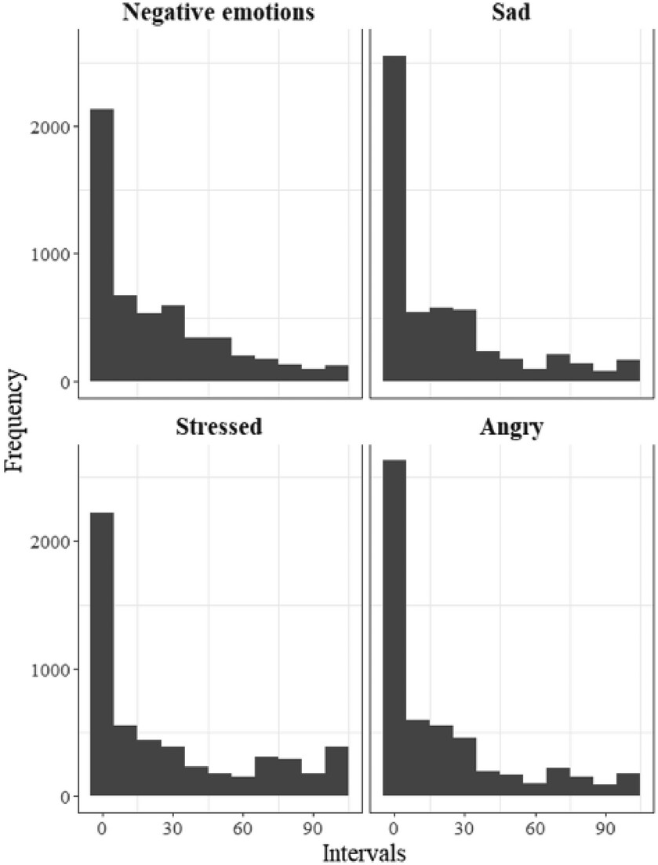

Slide 10
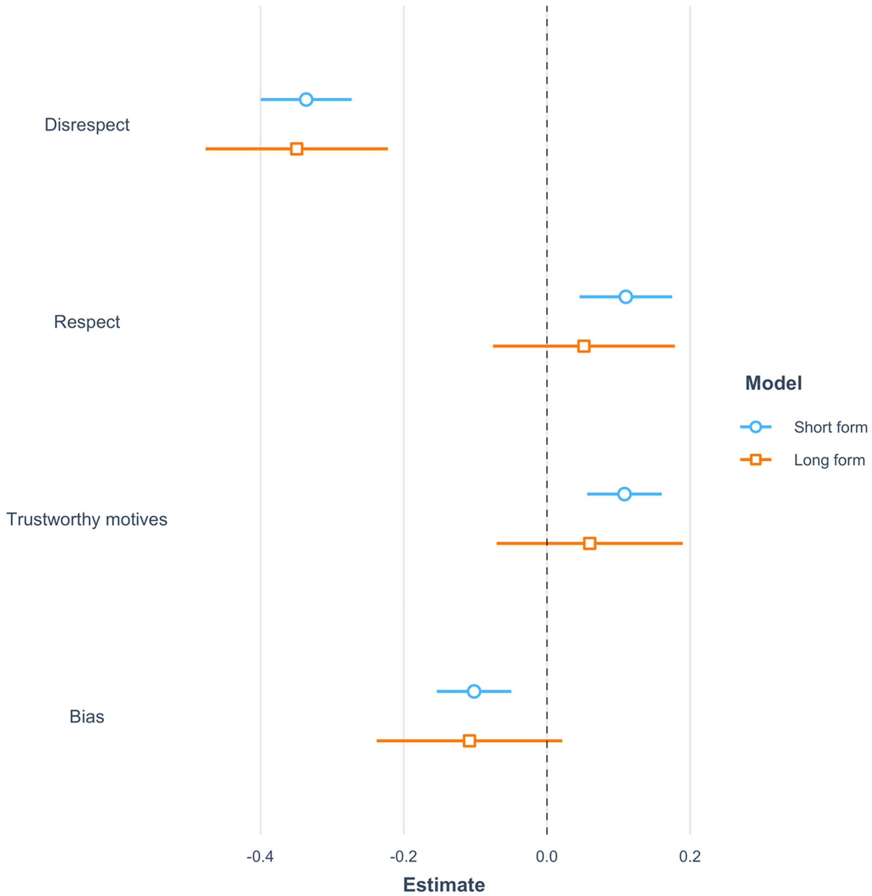

Slide 11
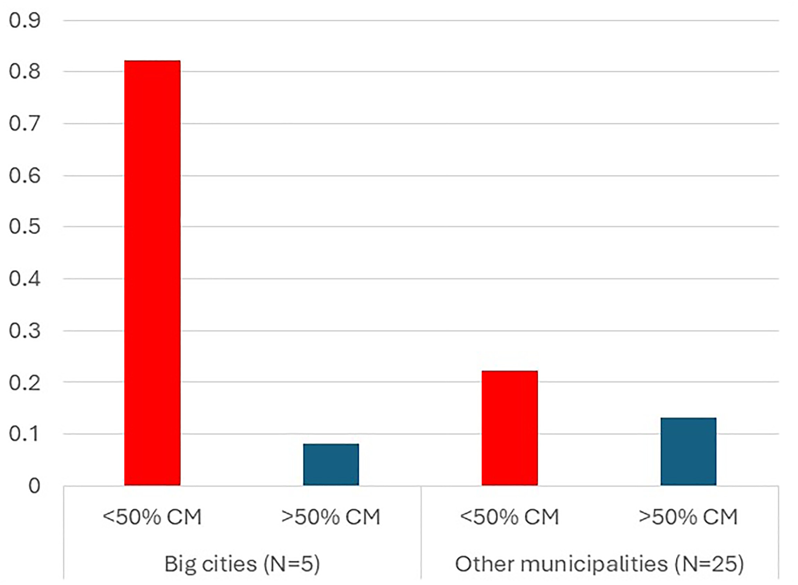

Slide 12
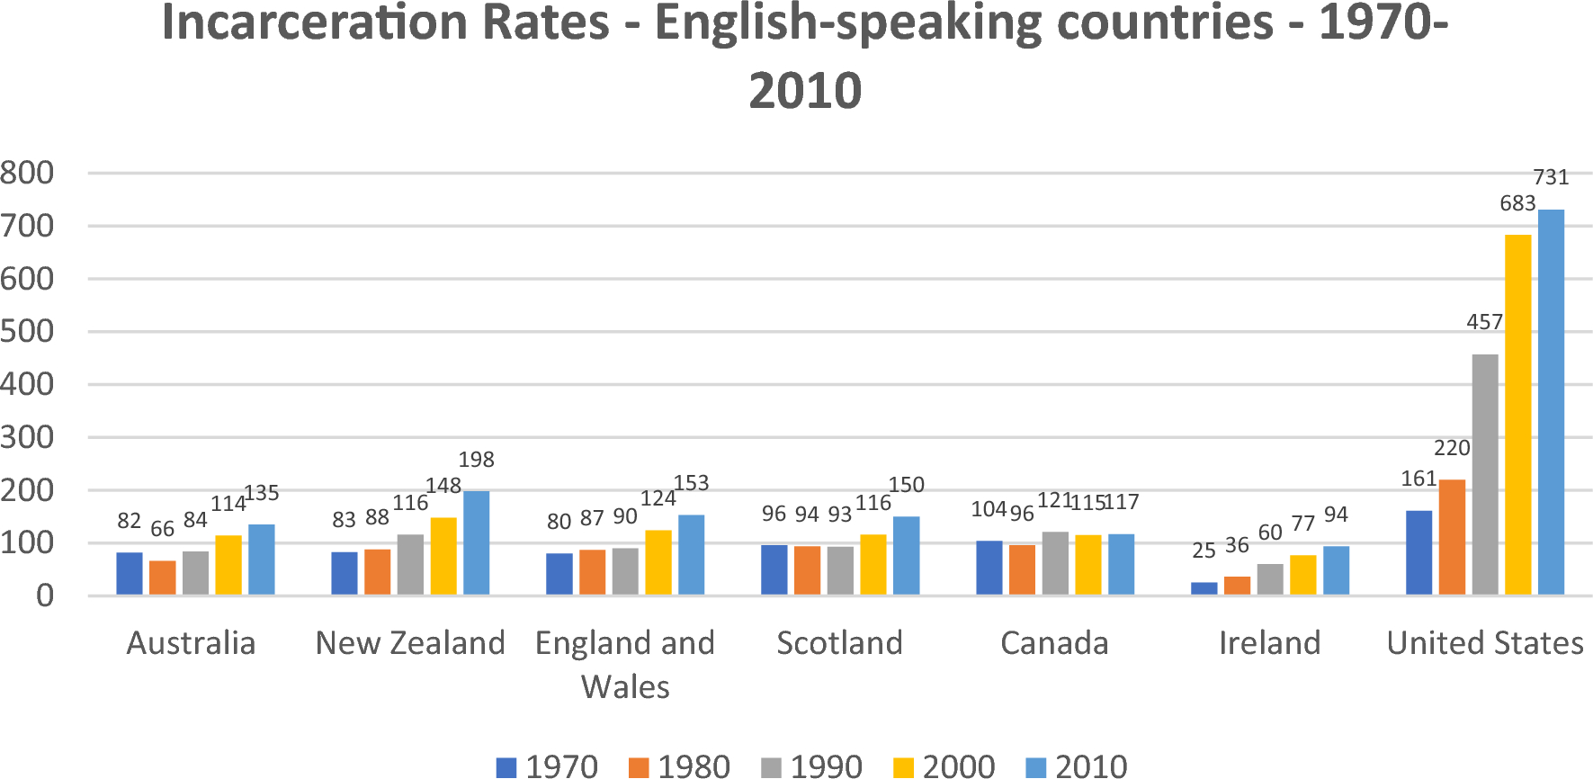

Slide 13
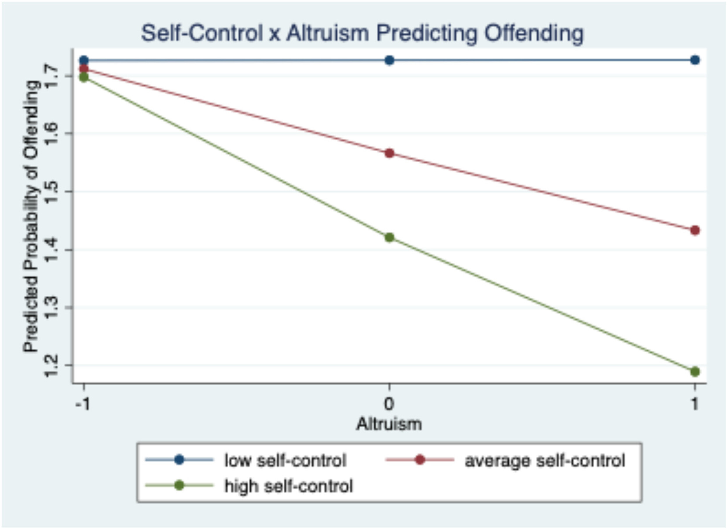

Slide 14
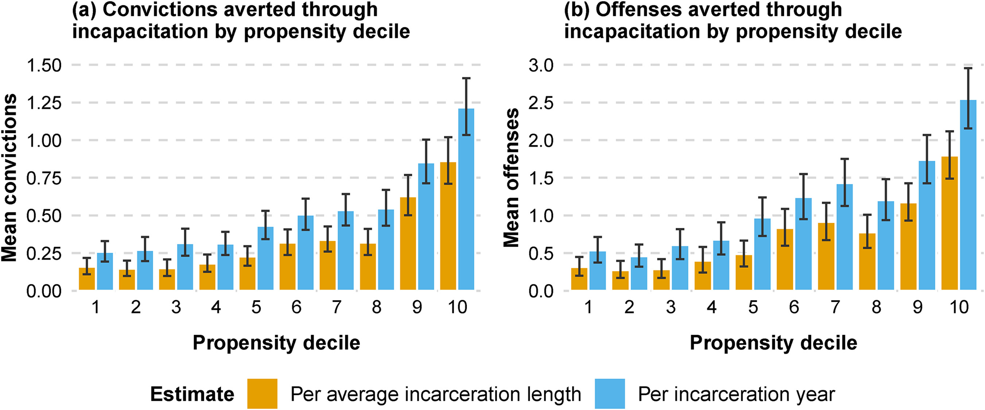

Slide 15
Some inspiration from data journalism

Slide 16
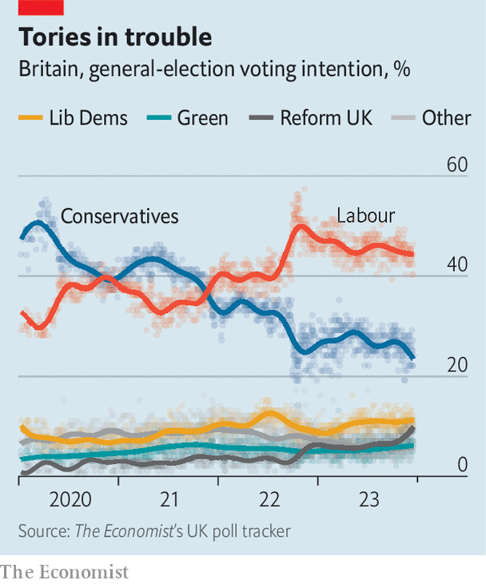
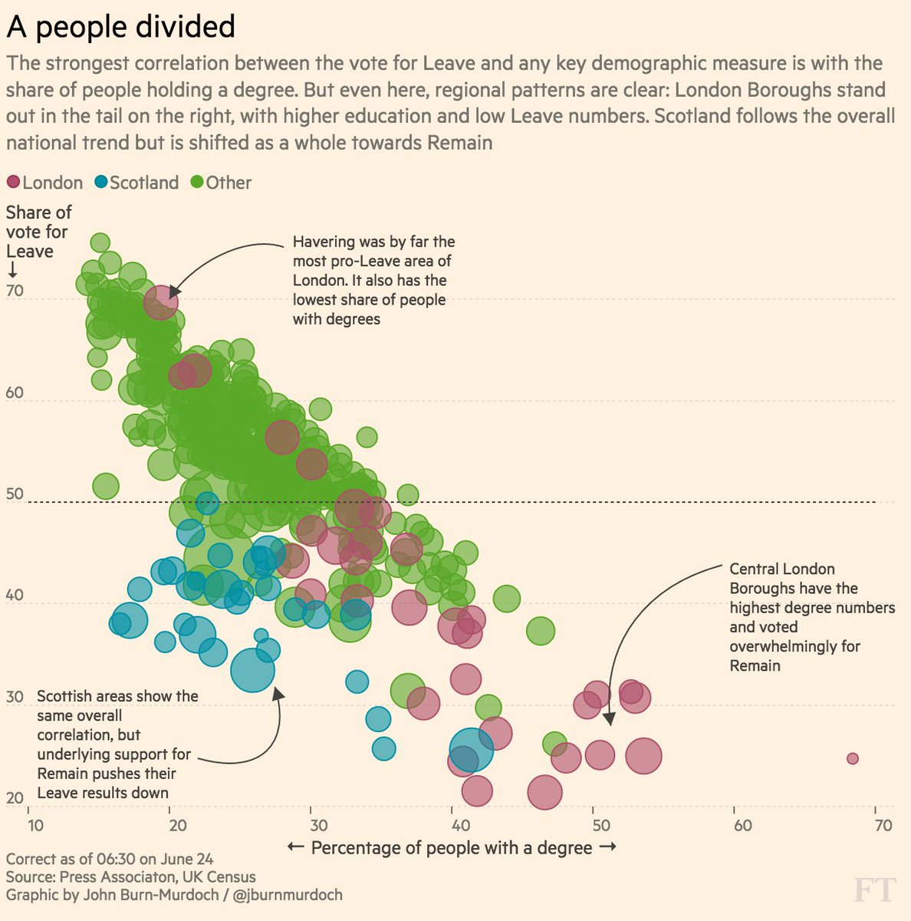
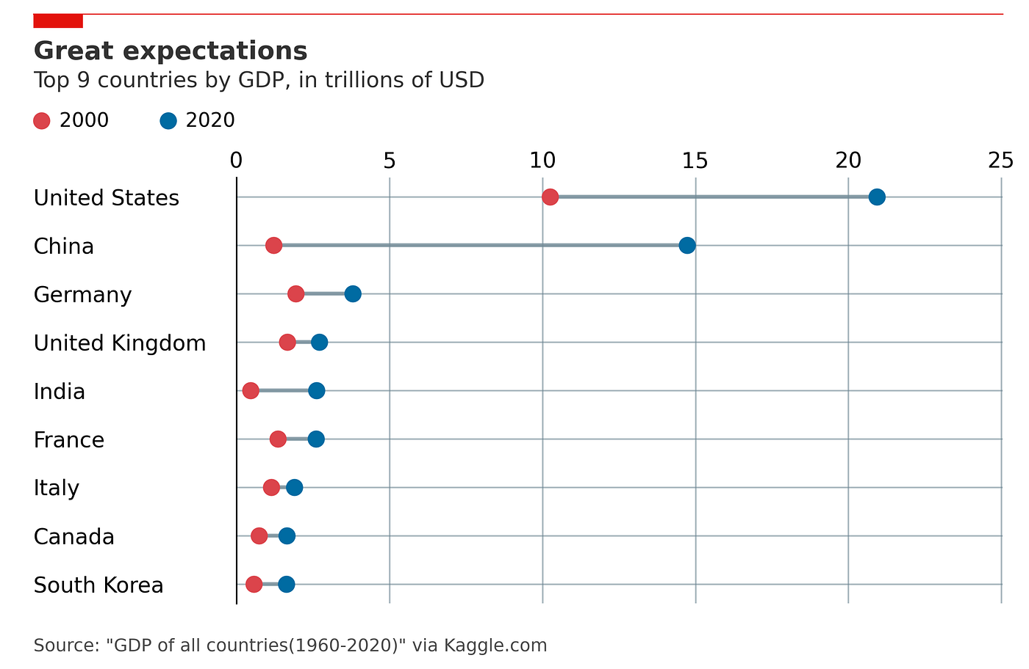

Slide 17
Not professional enough?

Slide 18
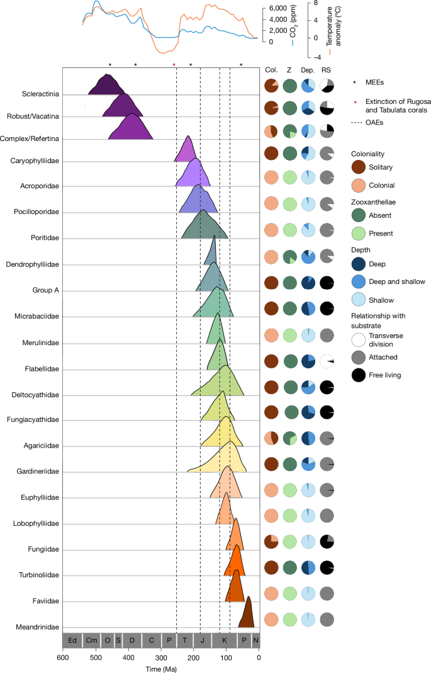
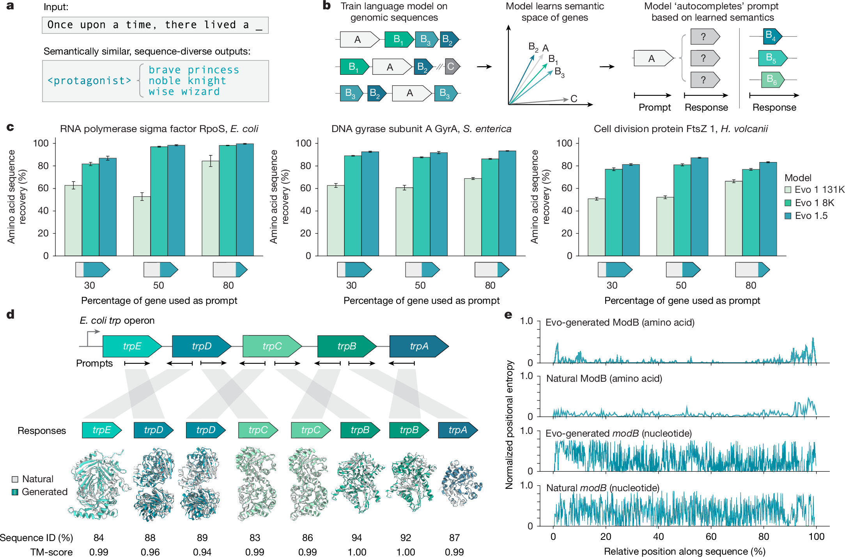
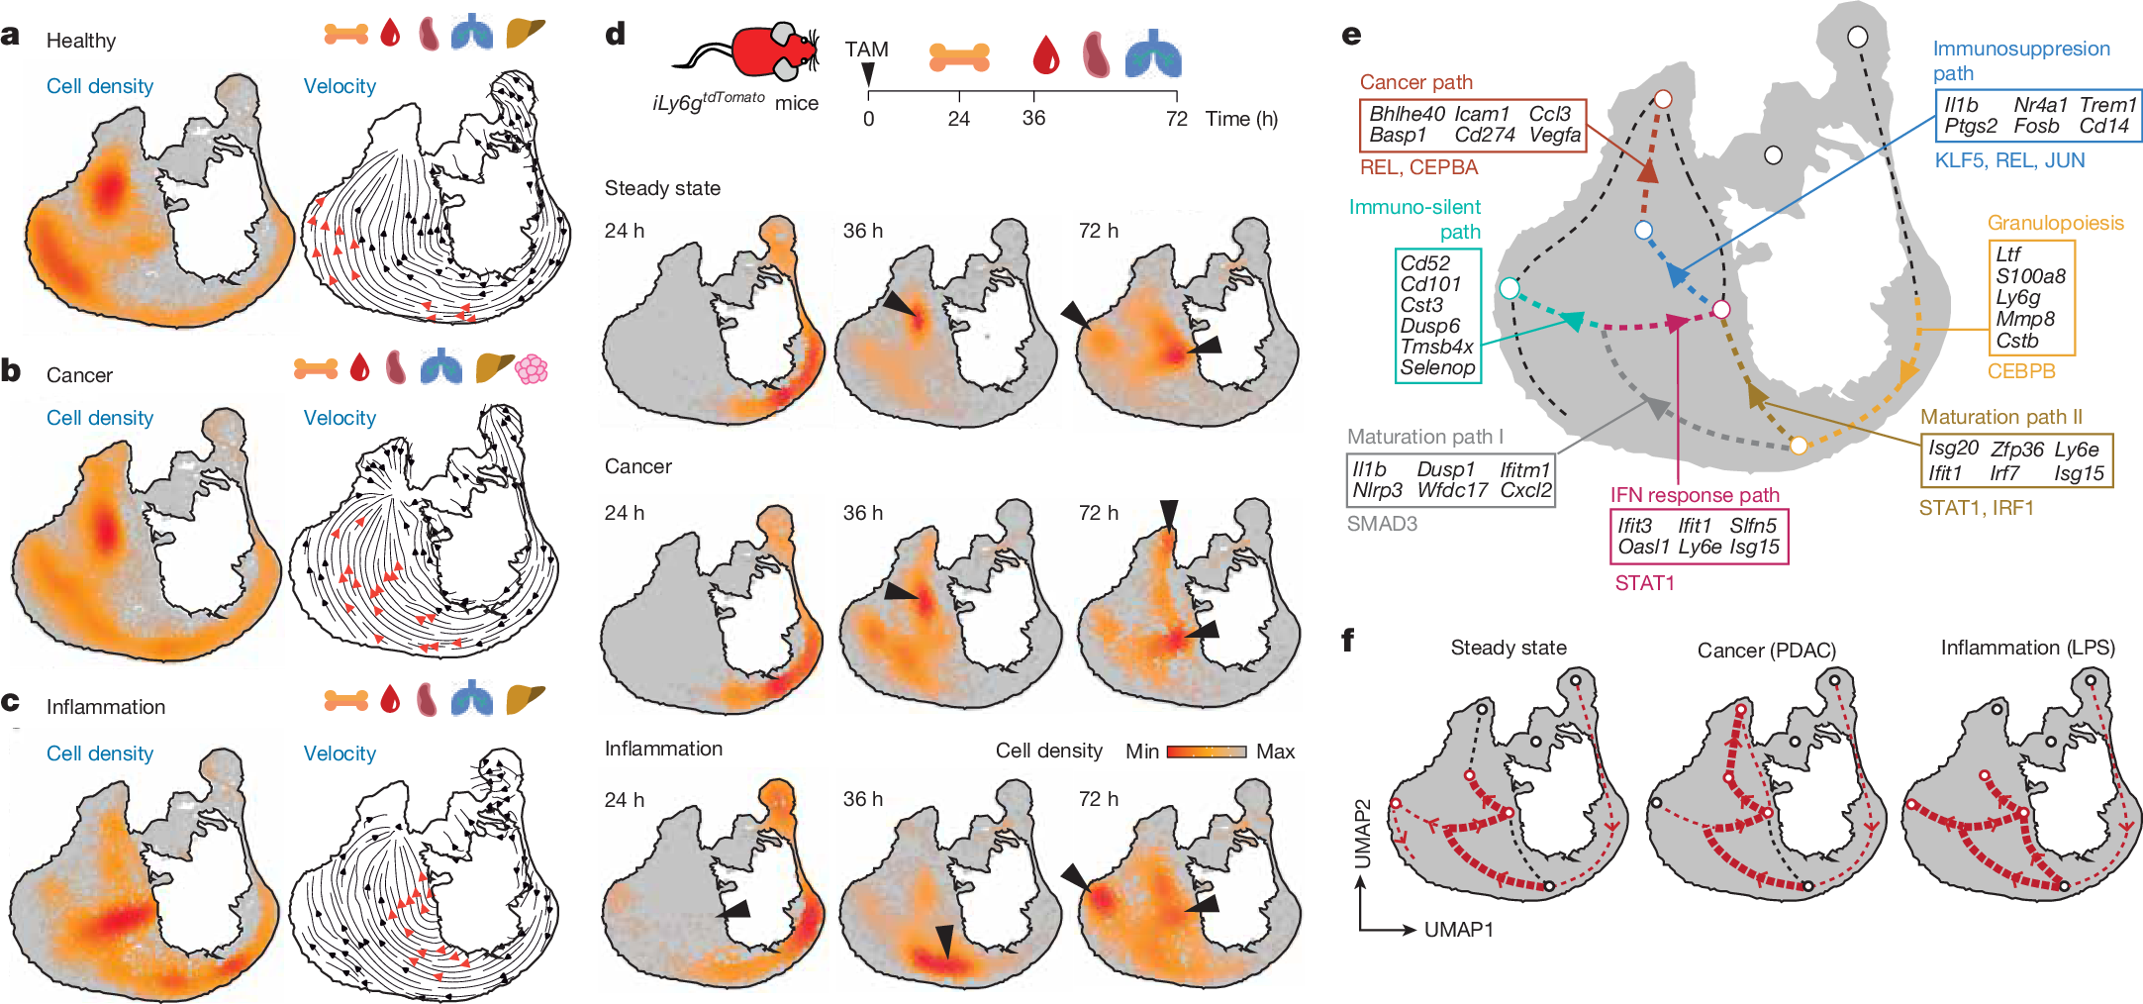

Slide 19
The font
If you wonder whether it’s too small, it probably is
  Small fonts are likely to be pixelated at the production stage and become illegible in the final pdf
Figures use sans-serif fonts - they are more legible
  Legibility ≠ readability

Slide 20
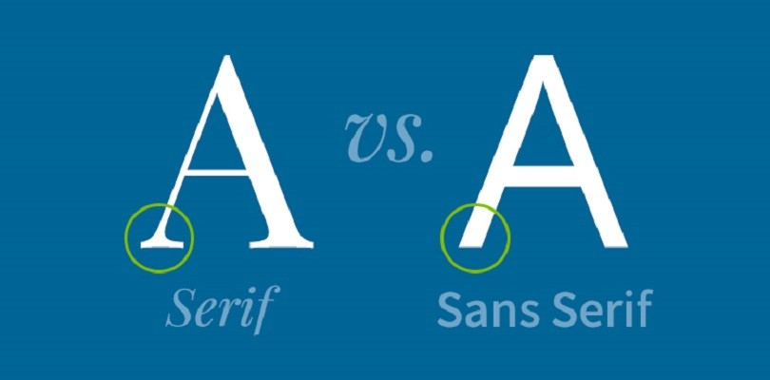
The font
If you wonder whether it’s too small, it probably is
  Small fonts are likely to be pixelated at the production stage and become illegible in the final pdf
Figures use sans-serif fonts - they are more legible
  Legibility ≠ readability

Slide 21
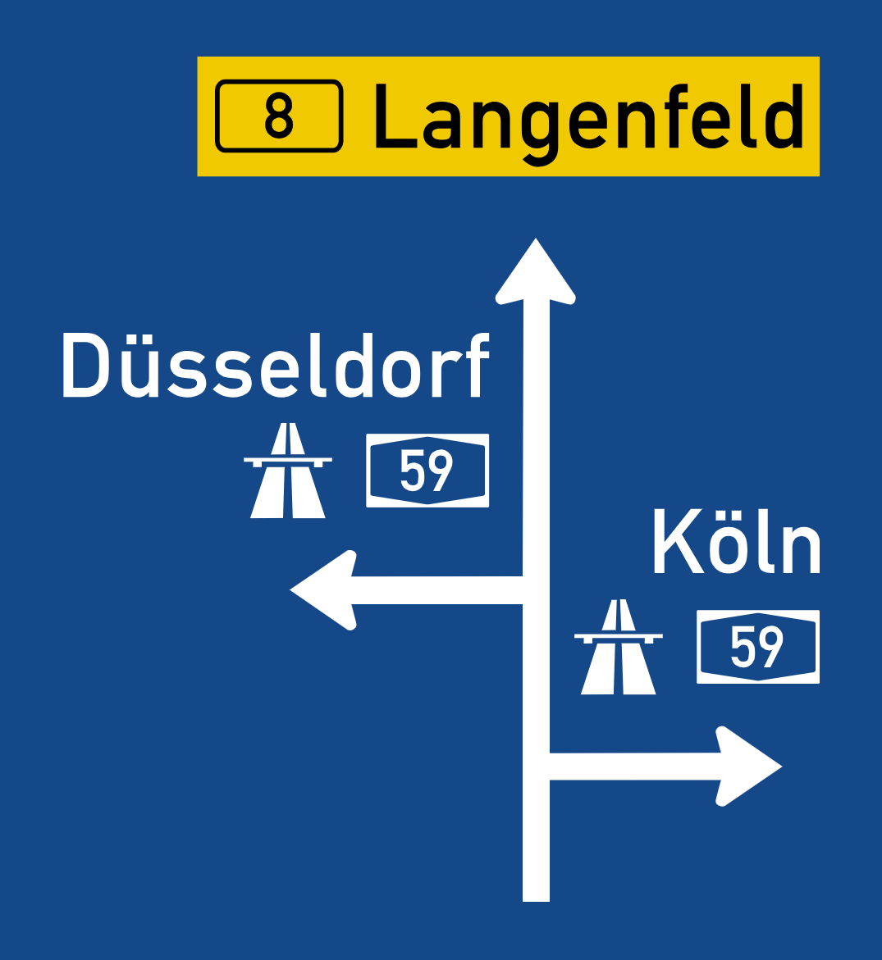
The font
If you wonder whether it’s too small, it probably is
  Small fonts are likely to be pixelated at the production stage and become illegible in the final pdf
Figures use sans-serif fonts - they are more legible
  Legibility ≠ readability

Slide 22
The font
If you wonder whether it’s too small, it probably is
  Small fonts are likely to be pixelated at the production stage and become illegible in the final pdf
Figures use sans-serif fonts - they are more legible
  Legibility ≠ readability
Habe nun, ach! Philosophie, Juristerei und Medizin, und leider auch Theologie durchaus studiert, mit heißem Bemühn. Da steh ich nun, ich armer Tor! Und bin so klug als wie zuvor; Heiße Magister, heiße Doktor gar und ziehe schon an die zehen Jahr Herauf, herab und quer und krumm Meine Schüler an der Nase herum –
Und sehe, daß wir nichts wissen können!

Slide 23

The font
If you wonder whether it’s too small, it probably is
  Small fonts are likely to be pixelated at the production stage and become illegible in the final pdf
Figures use sans-serif fonts - they are more legible
  Legibility ≠ readability
Calibri
Gill Sans MT
Trebuchet

Slide 24
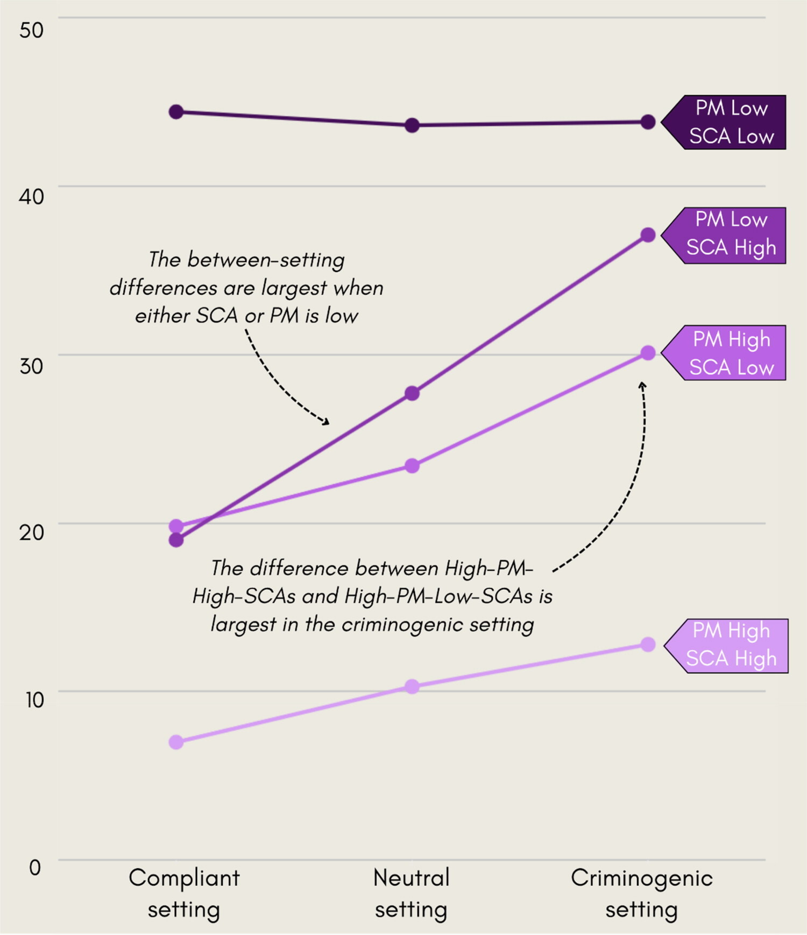

Slide 25

Method I: Flourish + Canva
Flourish is an online, mostly free-of-charge tool for data visualisation
  Achieving similar quality and aesthetics through coding would require very advanced skills
Canva can be used to refine Flourish-generated figure
  Broader selection of fonts, manual changes to the layout
  However: exporting high-resolution figures requires membership so consider free trial or similar PowerPoint functionalities

Slide 26

Method I: Flourish + Canva
Flourish is an online, mostly free-of-charge tool for data visualisation
  Achieving similar quality and aesthetics through coding would require very advanced skills
Canva can be used to refine Flourish-generated figure
  Broader selection of fonts, manual changes to the layout
  However: exporting high-resolution figures requires membership so consider free trial or similar PowerPoint functionalities

Slide 27
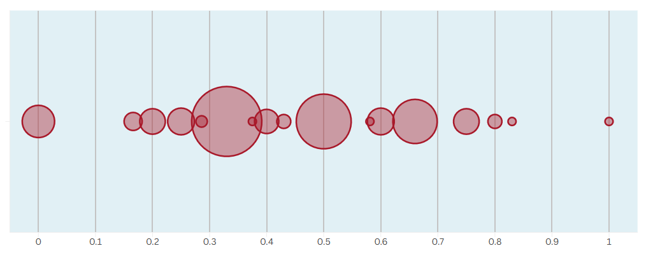
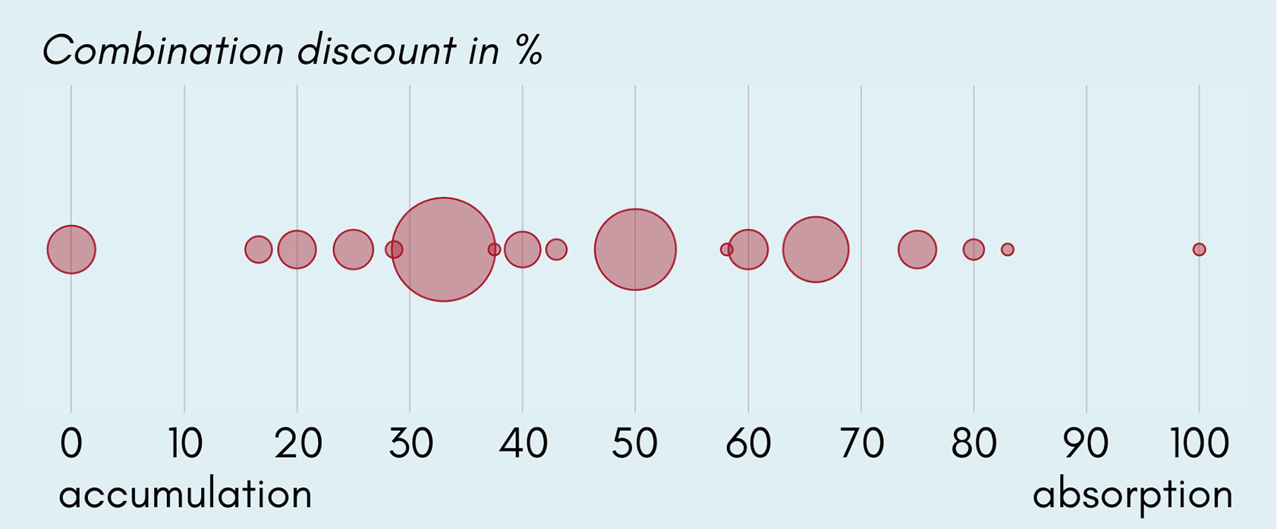

Slide 28
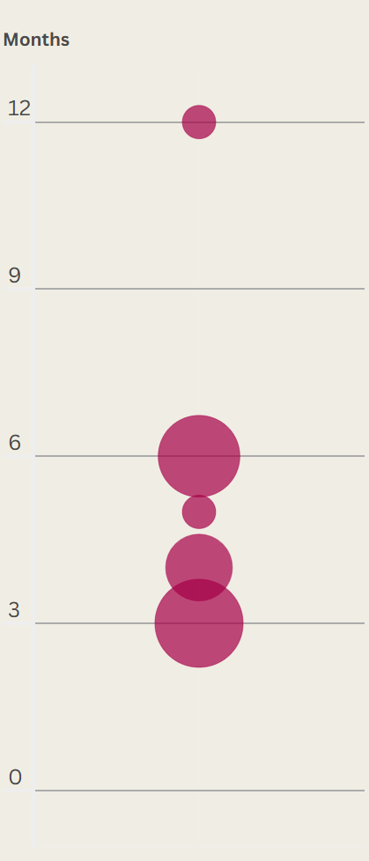
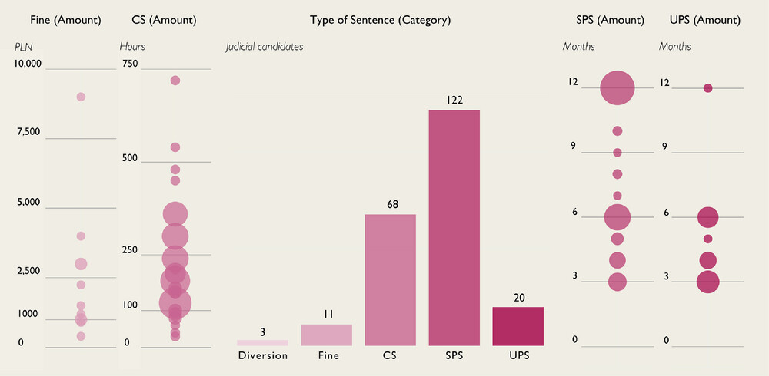

Slide 29
Method II: ggplot2 + Canva
While it’s very hard to match Flourish on aesthetics, it lacks a few functions useful for visualising statistics
  Error bars in figures
  Confidence intervals in coefficient plots
  Poor jittering functions

Slide 30
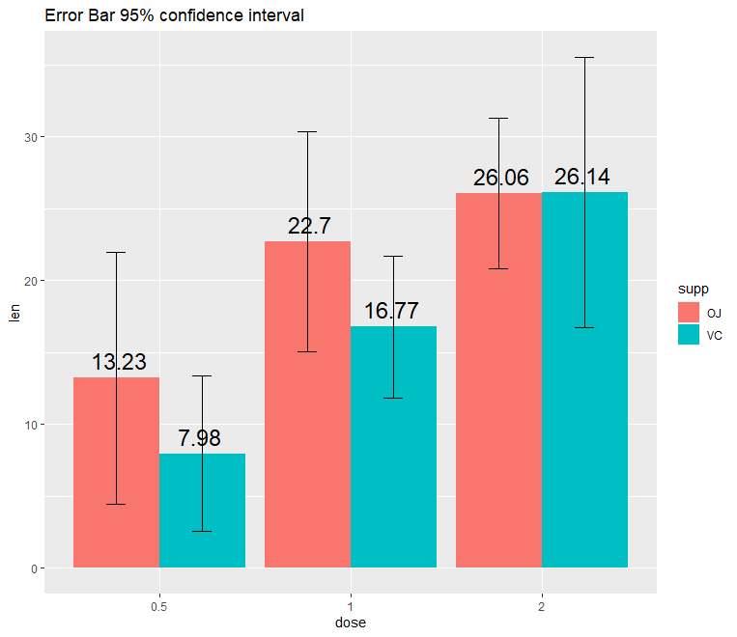
Method II: ggplot2 + Canva
While it’s very hard to match Flourish on aesthetics, it lacks a few functions useful for visualising statistics
  Error bars in figures
  Confidence intervals in coefficient plots
  Poor jittering functions

Slide 31
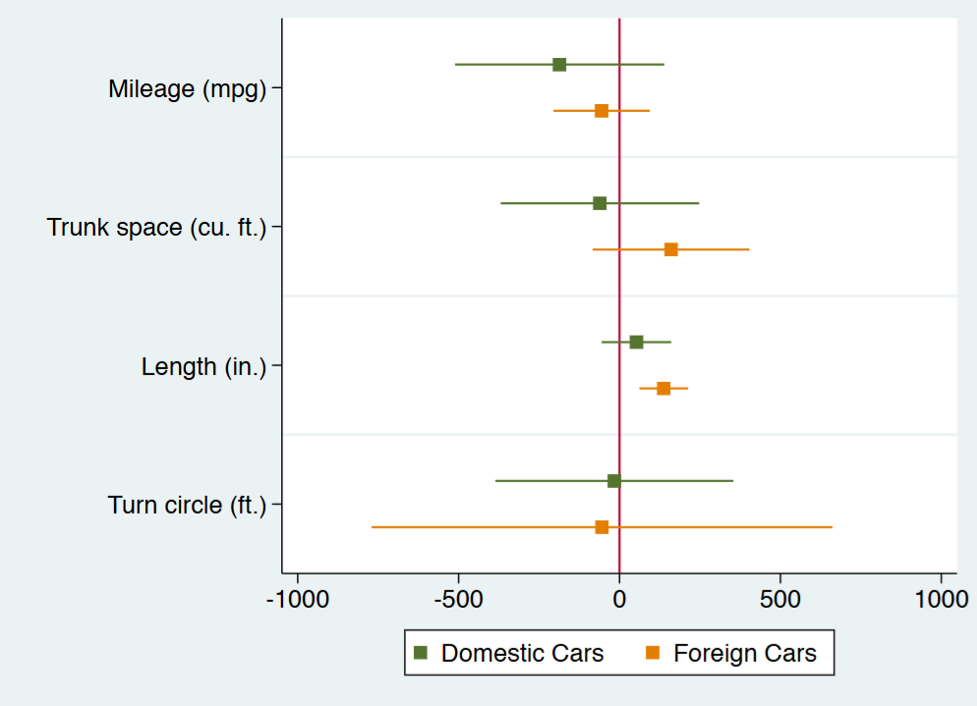
Method II: ggplot2 + Canva
While it’s very hard to match Flourish on aesthetics, it lacks a few functions useful for visualising statistics
  Error bars in figures
  Confidence intervals in coefficient plots
  Poor jittering functions

Slide 32
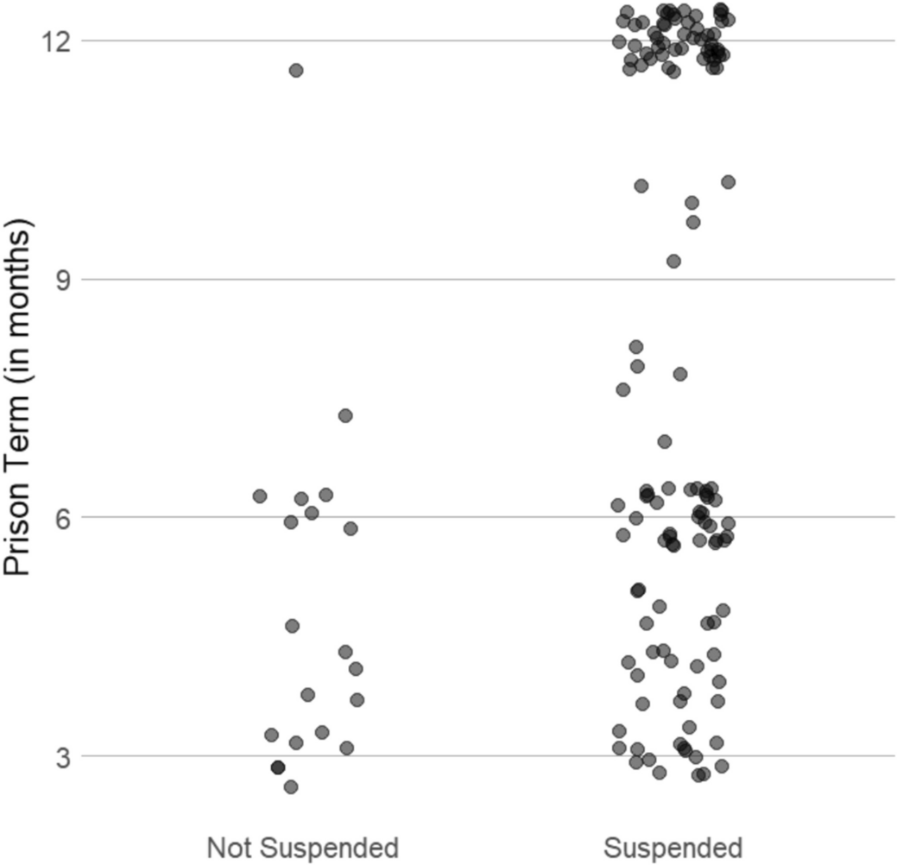
Method II: ggplot2 + Canva
While it’s very hard to match Flourish on aesthetics, it lacks a few functions useful for visualising statistics
  Error bars in figures
  Confidence intervals in coefficient plots
  Poor jittering functions

Slide 33
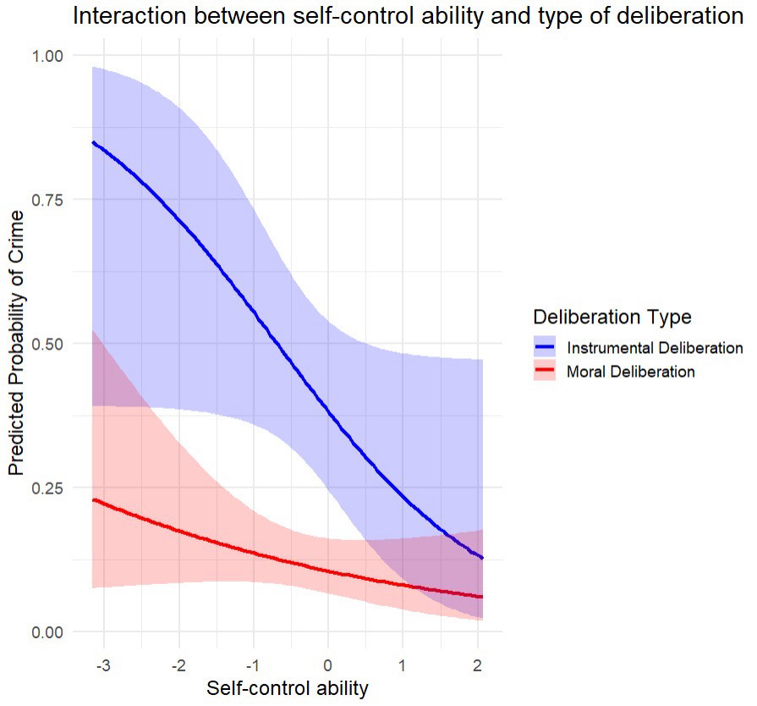
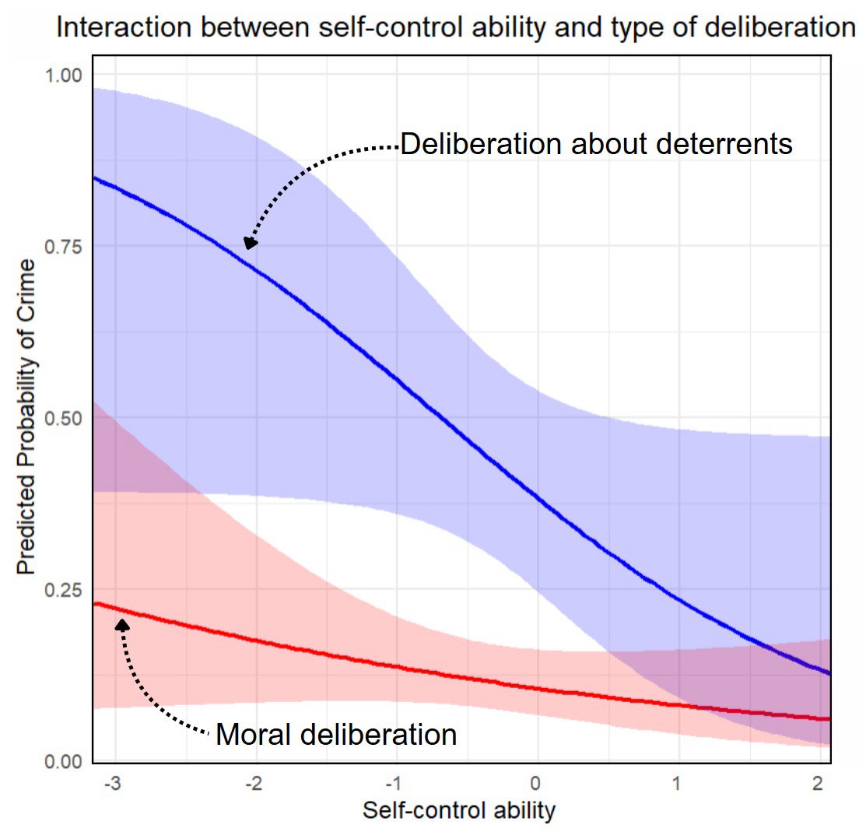

Slide 34
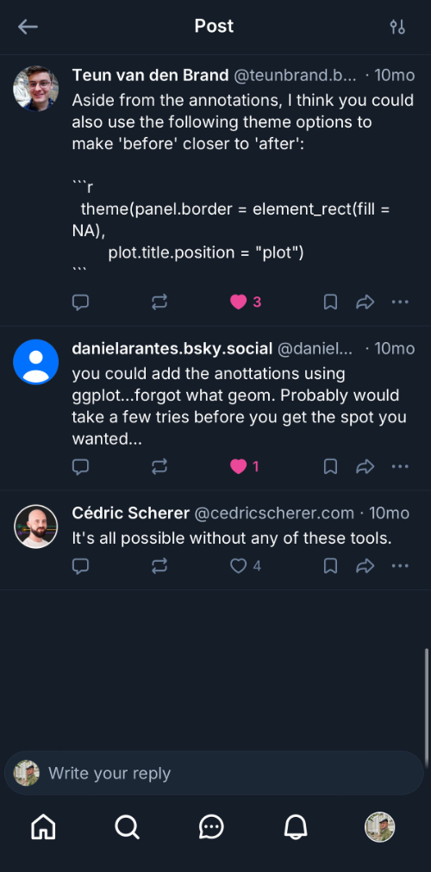

Slide 35
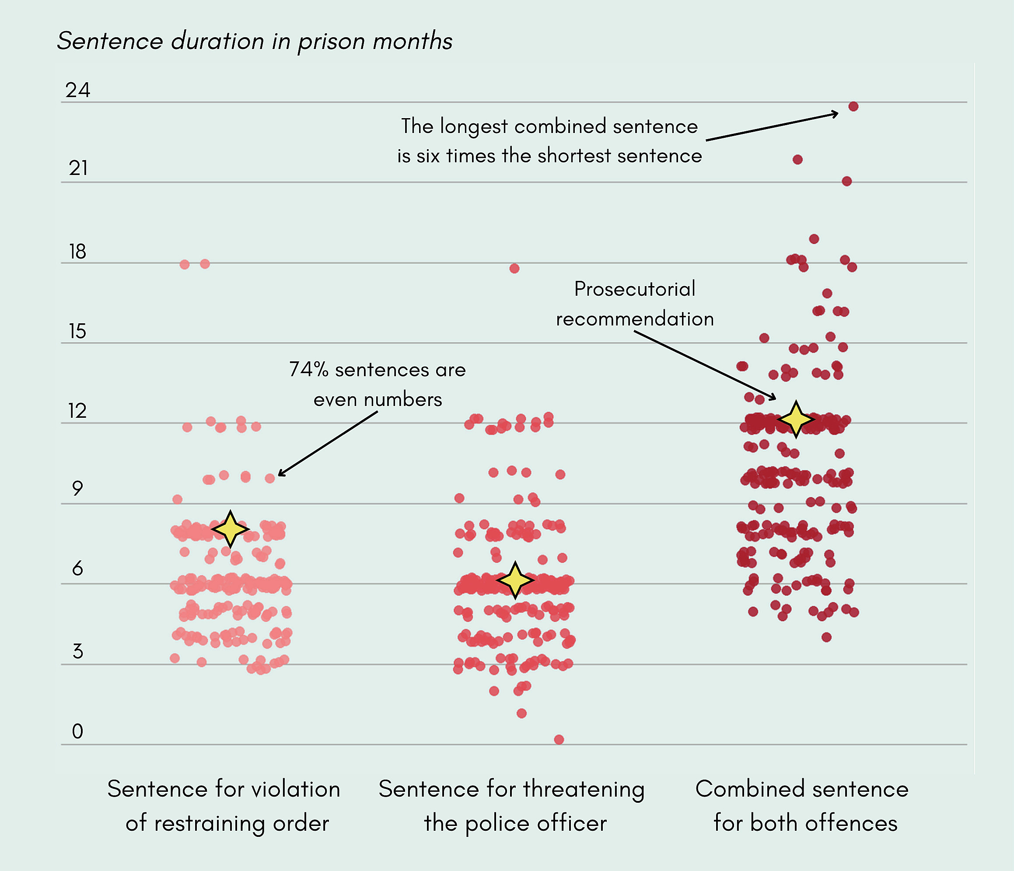

Slide 36
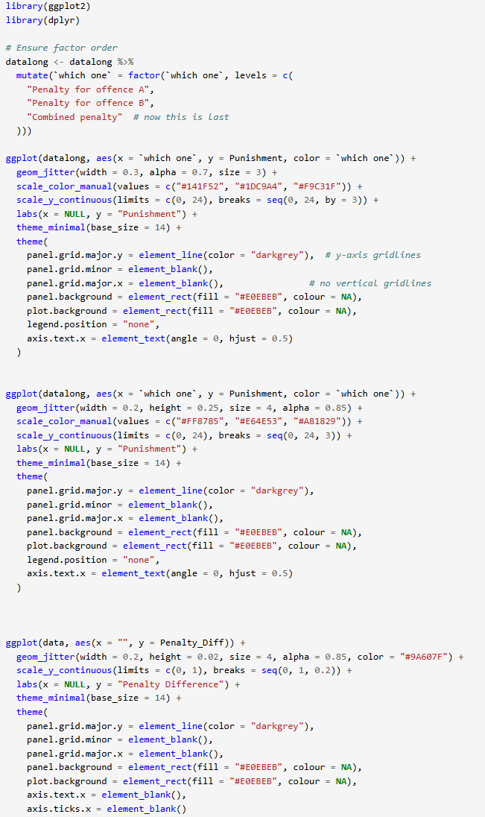

Slide 37
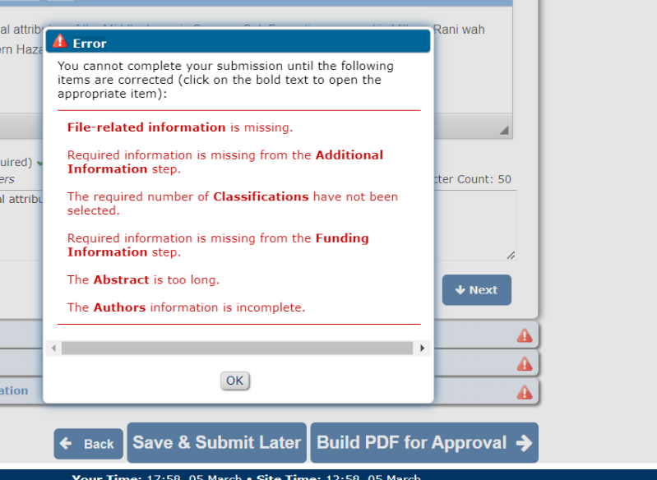
How to survive the production stage
Large publishers cash in large sums yet provide only
  1990s-style EM system to facilitate (?) review process
  DOIs, copyrights, etc.
  Poor formatting

Slide 38
How to survive the production stage
Large publishers cash in large sums yet provide only
  1990s-style EM system to facilitate (?) review process
  DOIs, copyrights, etc.
  Poor formatting

Slide 39
How to survive the production stage
Large publishers cash in large sums yet provide only
  1990s-style EM system to facilitate (?) review process
  DOIs, copyrights, etc.
  Poor formatting

Slide 40
How to survive the production stage (continued)
The editing by the production team is done in a sloppy, indiscriminate, and usually counterproductive way
Always check your proofs and make sure they didn’t introduce new mistakes to the text
Figures are very likely to be affected
  Resolution drops dramatically
  They could be placed in the wrong part of manuscript
  The scaling could be off
Raise your concerns early on and request to see the proofs after the changes
If needed escalate to the EiC
This is always easier before the publication

Slide 41
How to survive the production stage (continued)
The editing by the production team is done in a sloppy, indiscriminate, and usually counterproductive way
Always check your proofs and make sure they didn’t introduce new mistakes to the text
Figures are very likely to be affected
  Resolution drops dramatically
  They could be placed in the wrong part of manuscript
  The scaling could be off
Raise your concerns early on and request to see the proofs after the changes
If needed escalate to the EiC
This is always easier before the publication

Slide 42
How to survive the production stage (continued)
The editing by the production team is done in a sloppy, indiscriminate, and usually counterproductive way
Always check your proofs and make sure they didn’t introduce new mistakes to the text
Figures are very likely to be affected
  Resolution drops dramatically
  They could be placed in the wrong part of manuscript
  The scaling could be off
Raise your concerns early on and request to see the proofs after the changes
If needed escalate to the EiC
This is always easier before the publication

