Slide 1
The Potential of Randomised Controlled Trials
Dr Paula Clarke
School of Education
https://essl.leeds.ac.uk/education/staff/644/dr-paula-clarke-

Slide 2
Experiment – Randomised Controlled Trial
Randomisation
If there is a difference between groups in terms of pre-post change does this mean that the intervention has had an impact?

Slide 3
Causal evidence?
RCTs attempt to provide evidence of a causal link between the intervention and observable change
RCTs aim to reduce the likelihood of other possible causal explanations (sources of bias and confounding variables) for the change
For a really accessible introduction to RCTs see https://youtu.be/Wy7qpJeozec

Slide 4
Consolidated Standards of Reporting Trials (CONSORT)
CONSORT (2010) statement
CONSORT-ROUTINE – extension to include routinely collected data
CONSORT-SPI 2018 – extension to include items relevant to social and psychological interventions
Clarke et al. (2017)

Slide 5
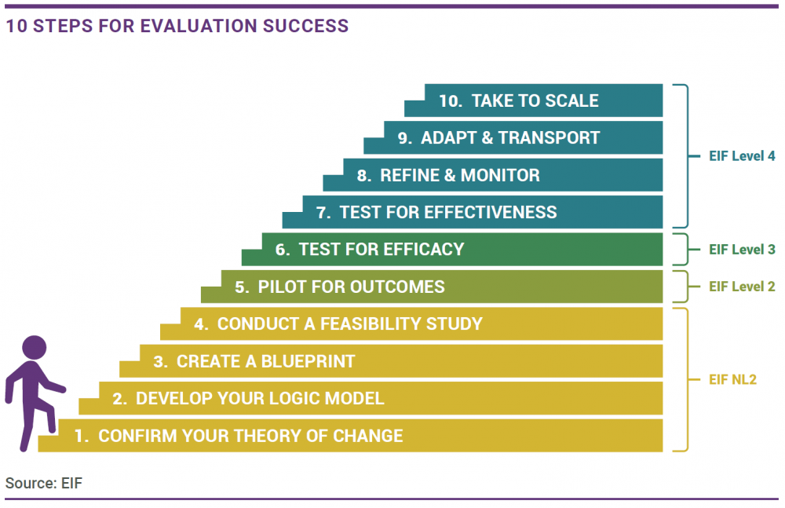
Stages of intervention development
RCTs
https://www.eif.org.uk/resource/10-steps-for-evaluation-success

Slide 6
Education Endowment Foundation (EEF)
“What works?”
https://educationendowmentfoundation.org.uk/projects-and-evaluation/evaluation/process-and-people
Has commissioned more than 10% of RCTs conducted in education globally
Pilot projects
Efficacy trials
Effectiveness trials
Scale up
Evidence toolkit for educators and policy makers
Synthesis of evidence – use of common measures across trials to facilitate this
Data collection panel – partner organisations for some trials
Trial
EEF
Independent evaluators
Delivery team
Impact Evaluation (RCT)
+ Process Evaluation

Slide 7
Impact on attainment – months progress
In EEF trials the headline outcome is reduced to a single number
What sits underneath this number?
What opportunities do the different elements of an RCT offer researchers?

Slide 8
RCT design decisions
Ethics
Control groups and conditions
Waiting control - business as usual
Active control
Cross over design
Parallel design
Time points
Multiple – how many?
Long term follow up?
Measures
Baseline
Primary outcomes
Secondary outcomes
Latent variables
Control measures
Randomisation
Individual
Clusters (e.g. group, class or school)
Stratification (e.g. sample divided into 5 regions then equal number from each region randomly allocated to condition)
Statistical analysis plan
Sample size calculations and statistical power – using effect size estimates from previous studies
Final design is outlined in an evaluation protocol
https://d2tic4wvo1iusb.cloudfront.net/documents/projects/REACH_Primary_Protocol.pdf?v=1669929326

Slide 9
Process evaluation
In the case of REACH Primary this was mixed methods and comprised
Surveys for school leaders
Surveys for teaching assistants
Observations of teaching assistant training
School visits (subsample of schools)
Observations
Interviews
Collection of relevant secondary data
Teaching assistant record keeping of students progress
Impact evaluation
Process evaluation

Slide 11
Blueprint
In the case of REACH Primary two blueprints were created:
Teaching assistant training
Intervention for students
With regards the intervention for students two main approaches were used:
Data driven design of intervention sessions tailored to students profiles of strengths and weaknesses in foundation reading skills. Based on an approach by Hatcher et al. (2006). TAs created intervention sessions appropriate to each students needs.
Scripted intervention sessions produced by the research team, with elements that could be reduced or extended depending upon the needs of the students, as determined by the TA.

Slide 12
Final thoughts
RCTs are a huge amount of work!
Large team efforts, requiring careful coordination and project management
Emotional impacts can be significant, considerable responsibility for making decisions that impact lives
The first four steps of the journey from theory of change to acceptability and feasibility are vital. More time and investment needed in these, and recognition that multiple cycles of development are needed. More emphasis on the early stages of intervention development could increase the chances of intervention effectiveness and the long term sustainability of interventions for use at scale.
Opportunities to build in design-based approaches and co-production into the early stages of intervention development. https://blogs.ed.ac.uk/lovetoread/. What are the best ways to involve stakeholders, including students and educators in these stages?
We wait to see the potential long term impacts of REACH and REACH Primary, but mid-term impacts also need to be considered. Too often trials end following an initial postest, there is potential for more longitudinal investigation.
Process evaluations tell an important story alongside the headline quantitative data. Which methodological approaches are best suited to this? Is their scope for using creative methods?

